Slide 1
Query by Humming Searching Sep 30th
Jiarui Xu(Jerry), Alexander Lerch

Slide 2
This week
Study onset detection algorithm
Use Yin algorithm and onset detection algorithm to find the note of audio
Coding to realize
Modify the note detection algorithm
Modify Baseline

Slide 3
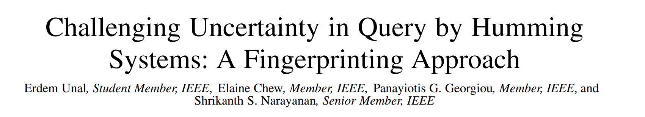
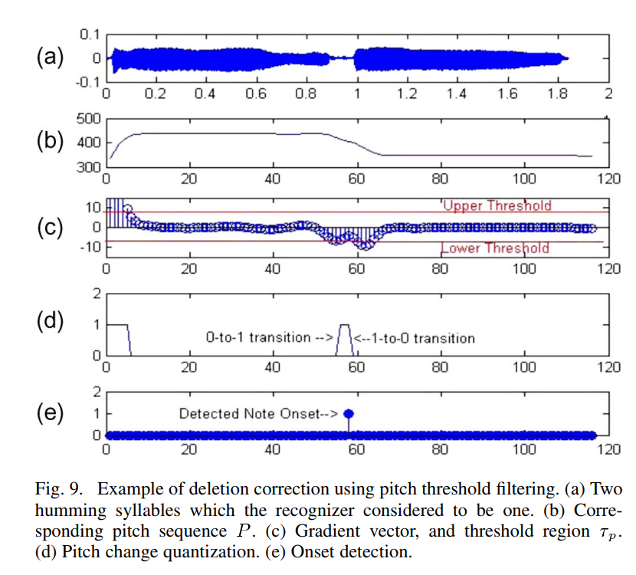
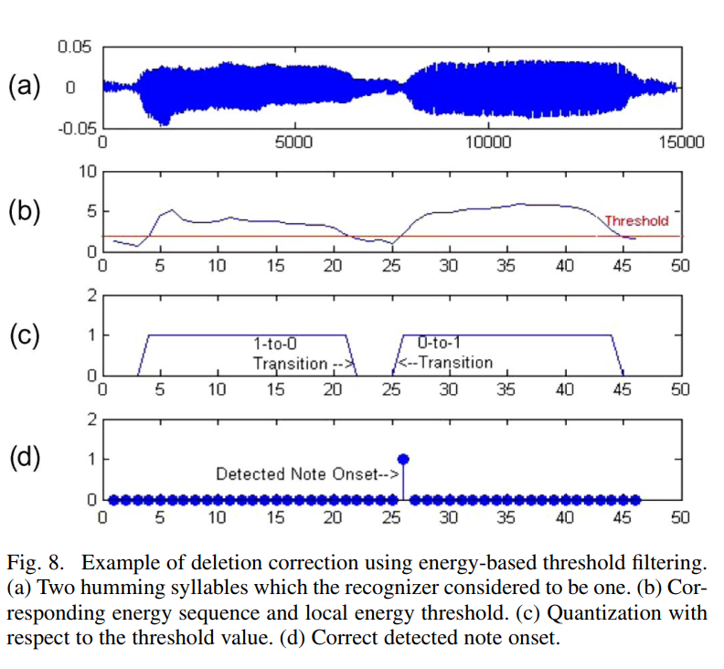
Study onset detection algorithm

Slide 4
Find the note of audio(mainly the length of note)
1.Use Yin find the f0 sequence of the audio
2.Convert f0 to pitch
3.Find the onset of each note
4.Statistical methods were used to find the most appropriate pitch between onset[i] and onset[i +1] as the pitch of the whole interval.
5. The last 50% (or 30%, as you can adjust) of each interval is mute.

Slide 5
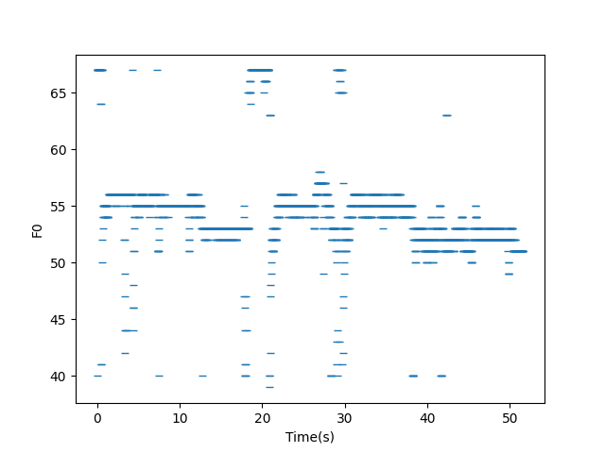
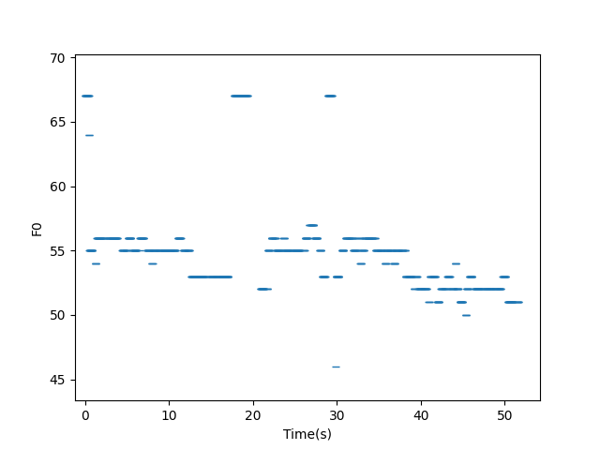
Comparison before and after optimization

Slide 6
Comparison before and after optimization

Slide 7
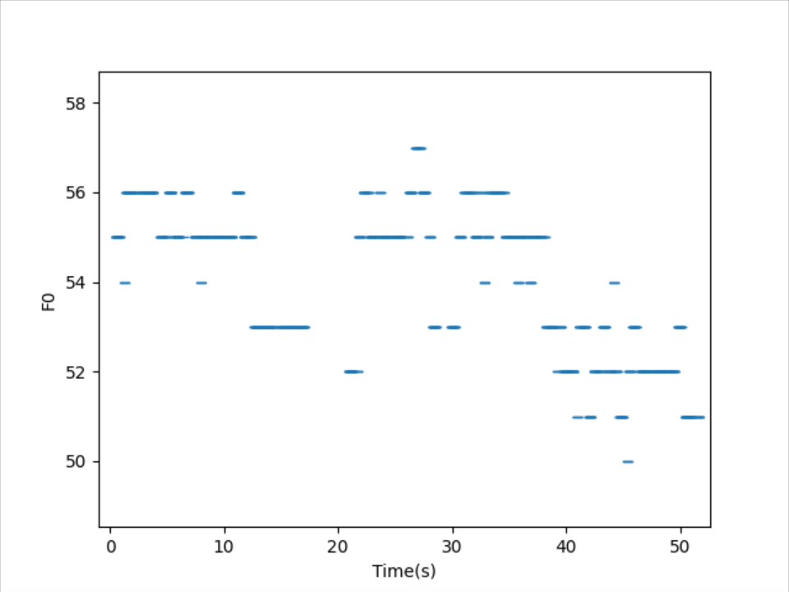
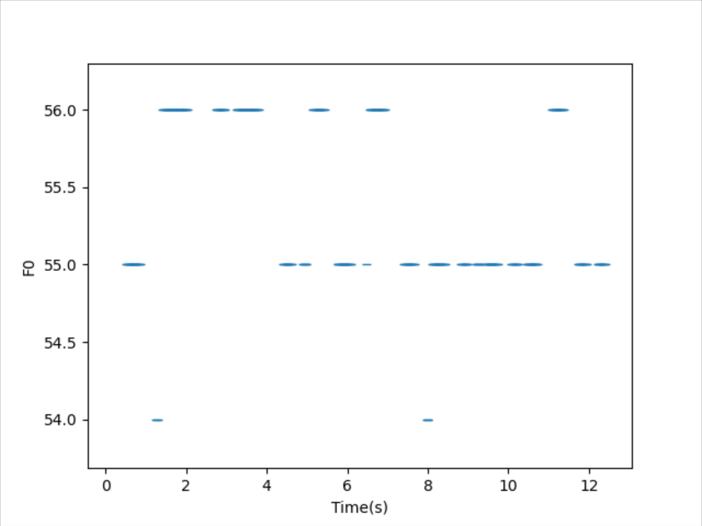
Look closely

Slide 8
Problems and Modification
1. Onset detection becomes difficult with continuous sounds.
2. The fundamental frequency of the noise is detected, and the noise needs to be distinguished in advance.
3. It is difficult to distinguish the intervals between notes.
Solution:
For problem 1, use statistic knowledge to calculate pitch changing
For problem 2, use filter to exclude noise
For problem 3, The last 50% (or 30%, as you can adjust) of each interval is mute.
New problem: The notes appear to be staccato and no longer continuous.

Slide 9
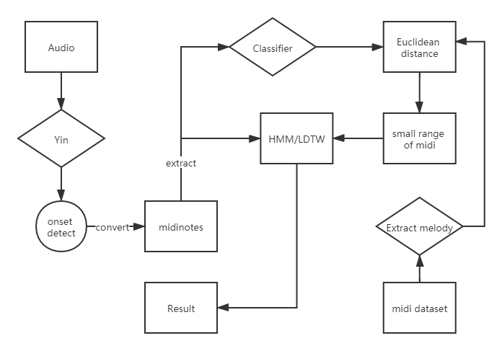
Modify Baseline

Slide 10
Thank you!

